Slide 1
Making maps in R
Class 9

Slide 2
Agenda
Project 1 Review
Homework 3
Shapefiles in R
Leaflet
Base maps
Lines
Shapes
Points
Legends
Colors
Heatmaps
Add Ons & Other things
Shiny integration
Leaflet Proxy

Slide 3
Project 1
Mean | 92.6555556
Median | 90
StdDev | 5.07267446

Slide 4
Project 1 Review
Difference between pages and tabs
We will do a mini reactive review during Thursday’s class
Turning in assignments - Please email me with your repo AND shinyapps.io links at gla@andrew.cmu.edu

Slide 5
Homework 3

Slide 6
Leaflet

Slide 7
Making sure you have the right stuff
Install these packages:
rgdal: https://github.com/cran/rgdal/blob/master/inst/README
rgeos
sp
leaflet
leaflet.extras

Slide 8
What is Leaflet?
R version of the Javascript API
One of the ways to get interactive maps
Others include: tmap & mapview
https://rstudio.github.io/leaflet/

Slide 9
Getting Data in

Slide 10
Spatial Data in R
Sometimes your data source will be a dataframe, other times the information will be included in your spatial object
Other times it will be points on a CSV, luckily leaflet doesn’t need any mutation with data like this.

Slide 11
Reading Spatial Data
readOGR() is your one size fits all spatial data function (from the rgdal package)
Shapefile:
geoJSON:

Slide 12
About Spatial Data
3 kinds of spatial Data: Lines, Polygons, Points
All spatial objects’s have the same parts
@data: The dataframe
@coords: Spatial data
@bbox: Bounding box
@proj4string: The projection string

Slide 13
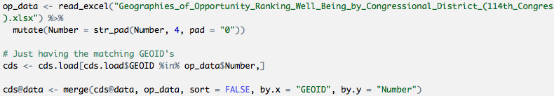
Merging Spatial Data
A normal merge of the dataframe will often resort the data, but will not resort the points.
How do we get around this? Turn off sorting!

Slide 14
Basemaps

Slide 15
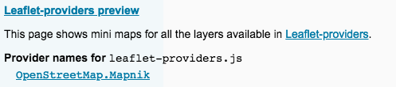
Choosing a basemap
Basemaps should complement the type of map you are creating.
Reference: https://leaflet-extras.github.io/leaflet-providers/preview/

Slide 16
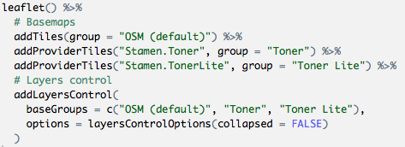
Giving users options
Layer control let you give users the option to choose their basemap
Layer control also has a overlayGroups which works with any other layer added to the map

Slide 17
Layer Controls
baseGroups (list of basemaps as characters)
overLayerGroups (list of all all other groupings)
position (character argument, ie: “bottomright”, “topleft”)
data (piped in map)
collapsed (boolean,)

Slide 18
Shapes
Circles, Lines & Polygons

Slide 19
Shapes vs lines: one just connects
lng (fortified data)
lat (fortified data)
layerId (for input use)
group (for layerControls)
stroke (Boolean, outline)
color (outline, takes hex)
weight (outline strength)
opacity (alpha of the line)
fill (boolean)
fillColor (takes hex)
fillOpacity (alpha of fill)
and More!

Slide 20

Basic Shape

Slide 21
Line with simple Pop up

Slide 22
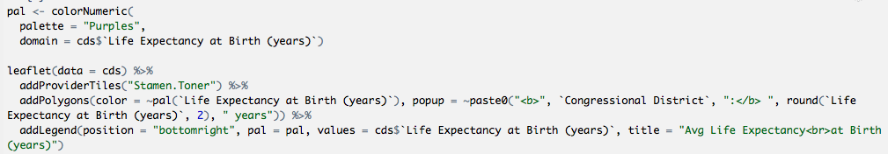
Shape Popup with Colors

Slide 23
Legends
position (character argument, ie: “bottomright”, “topleft”)
pal (palette you made or from colorBrewer)
values (domain from data element)
na.label (character, default “NA”)
bins (buckets)
colors
labFormat (labelFormat() options)
title
className (for custom CSS)
layerId (for input use)
group (for layerControls)
digits (numeric values in labels)
big.mark (thousands seperator)
transform (function to change labels)

Slide 24
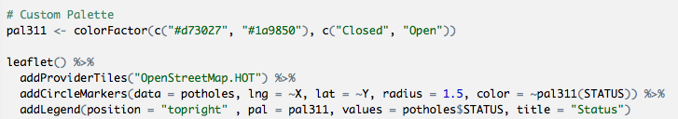
Circle Markers with custom palette

Slide 25
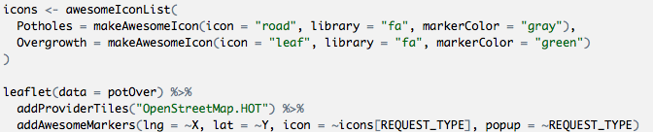
Custom awesome markers

Slide 26

Heatmap (leaflet.extras)

